Slide 1

Using GitHub to Automate and Deliver Technology Projects
Nick Beaugeard

Slide 2

Background
Software architect for last 25 years
Ran 4 successful startups
Ran teams from 1 to 400
Delivered a lot of products.

Slide 3
Technology used in this presentation
Browser – Google Chrome
Snipping Tool (Comes with Windows 10)
Visual Studio Code (code.visualstudio.com)
Project Documentor (github.com/nickbeau/project-documentor)
Pandoc (pandoc.org)

Slide 4

Technology Projects
Documentation
Reporting
Deliverable

Slide 5
A Real World Example
Mforce
Meeting Software, traditionally written in legacy .NET Framework
No Documentation
No Effective bug tracking
No Project Management
No Issue Management

Slide 6
Setting Up Your Project
Setup the Repo
Setup the Labels
Complete the Requirements
Produce the Specification

Slide 7

Demo – Setting up a Repo

Slide 8
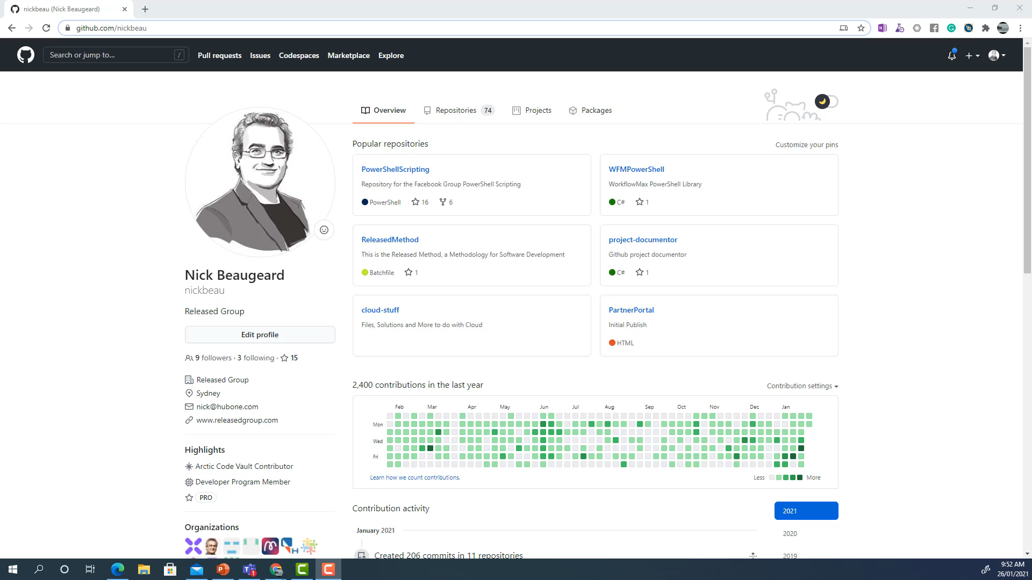

Slide 9

Demo – Setting up the Labels

Slide 10
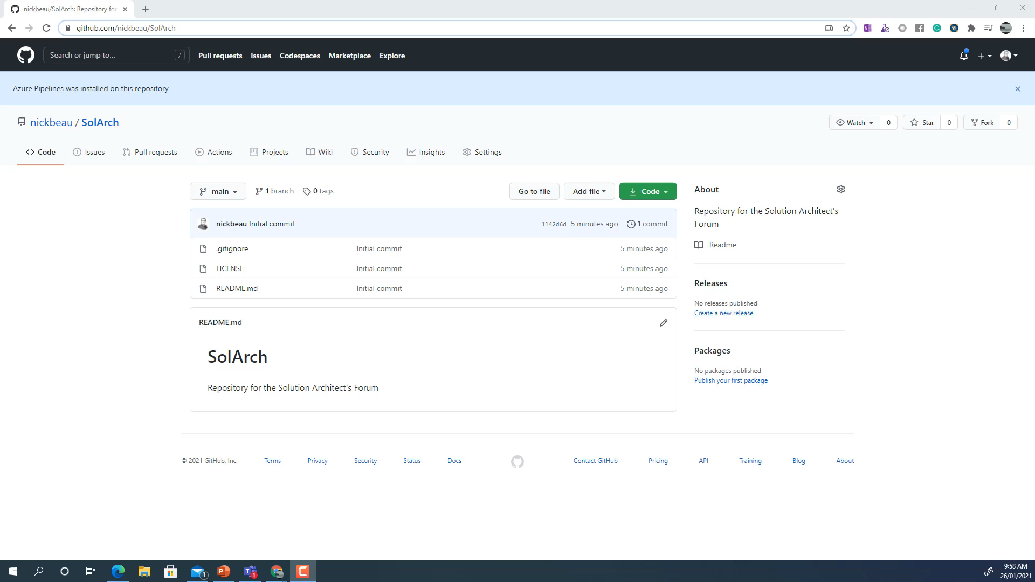

Slide 11

Demo - Completing Requirements

Slide 12
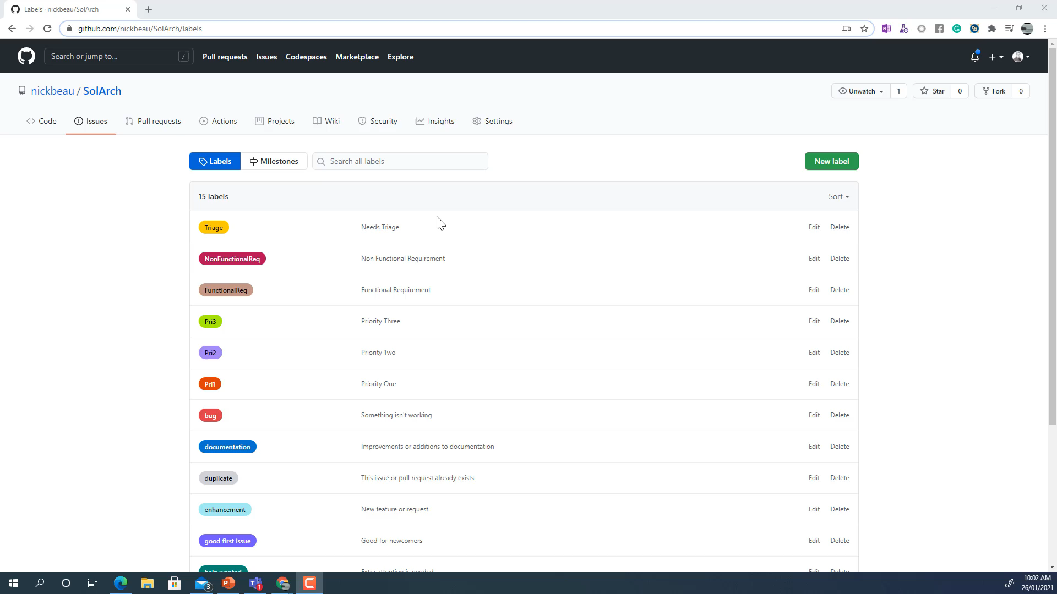

Slide 13

Demo – Produce Specifications

Slide 14
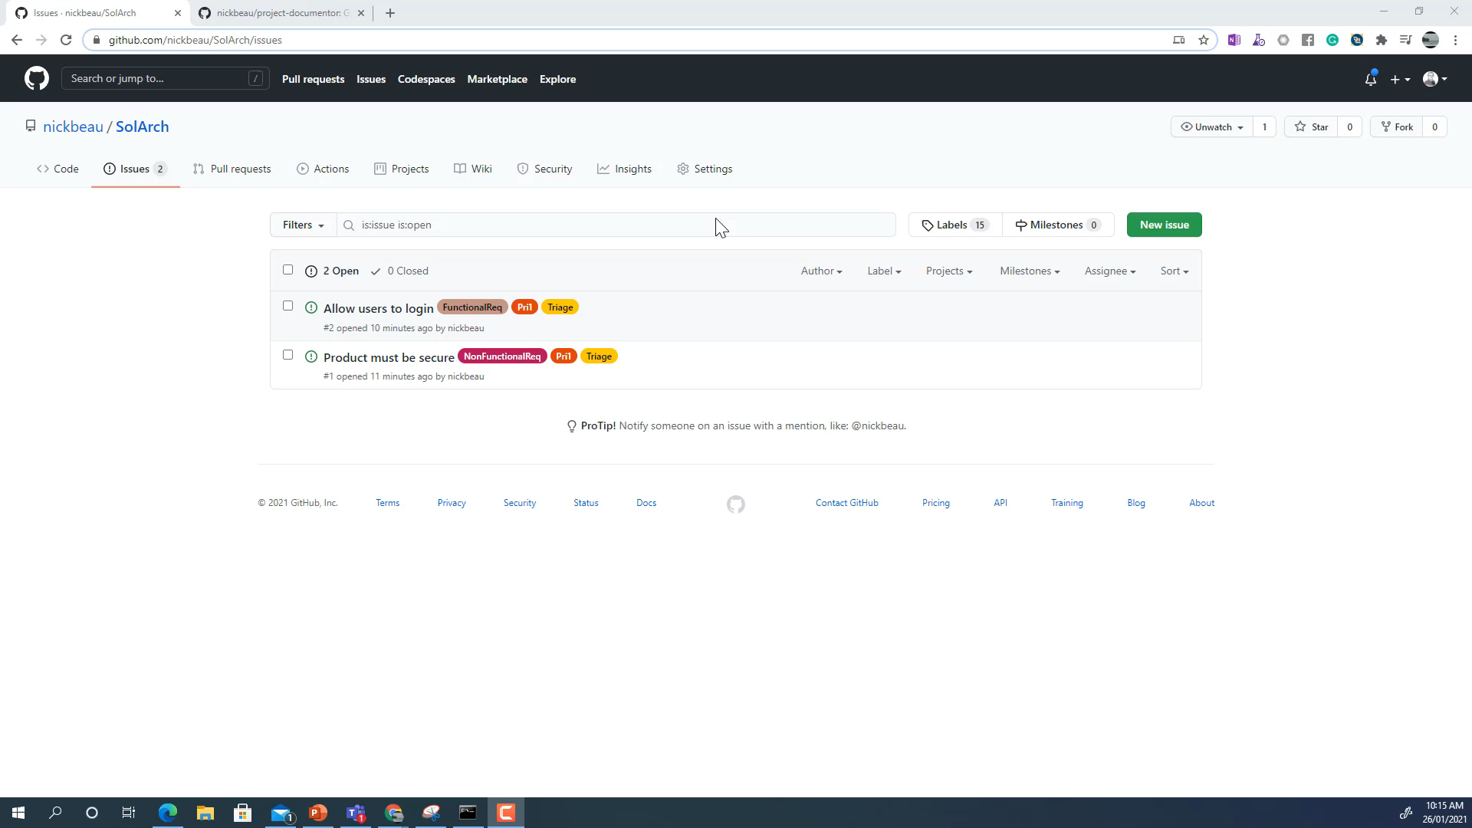

Slide 15
Running the Project
Triage Meetings
Bug Management
Producing Deliverable Documentation
Producing Project Documentation

Slide 16


Triage Meeting
For Each Item
Assign
Resolve – No Repo
Resolve – Won’t Fix
Punt
The Triage team works as a peer team.

Slide 17

Bug or “Defect” Management
See nickbeau.github.io/ReleasedMethod
Person who finds the bug is the originator
Triage processes the bug and may hand to a resolver
Resolver fixes the bug and assigns to the originator
Originator closes the bug, sends to the resolver or triage

Slide 18
Producing Deliverable Documentation
Documentation can be written in Markdown (markdownguide.org)
It is stored in GutHub

Slide 19
Demo – Producing Deliverable Documentation

Slide 20
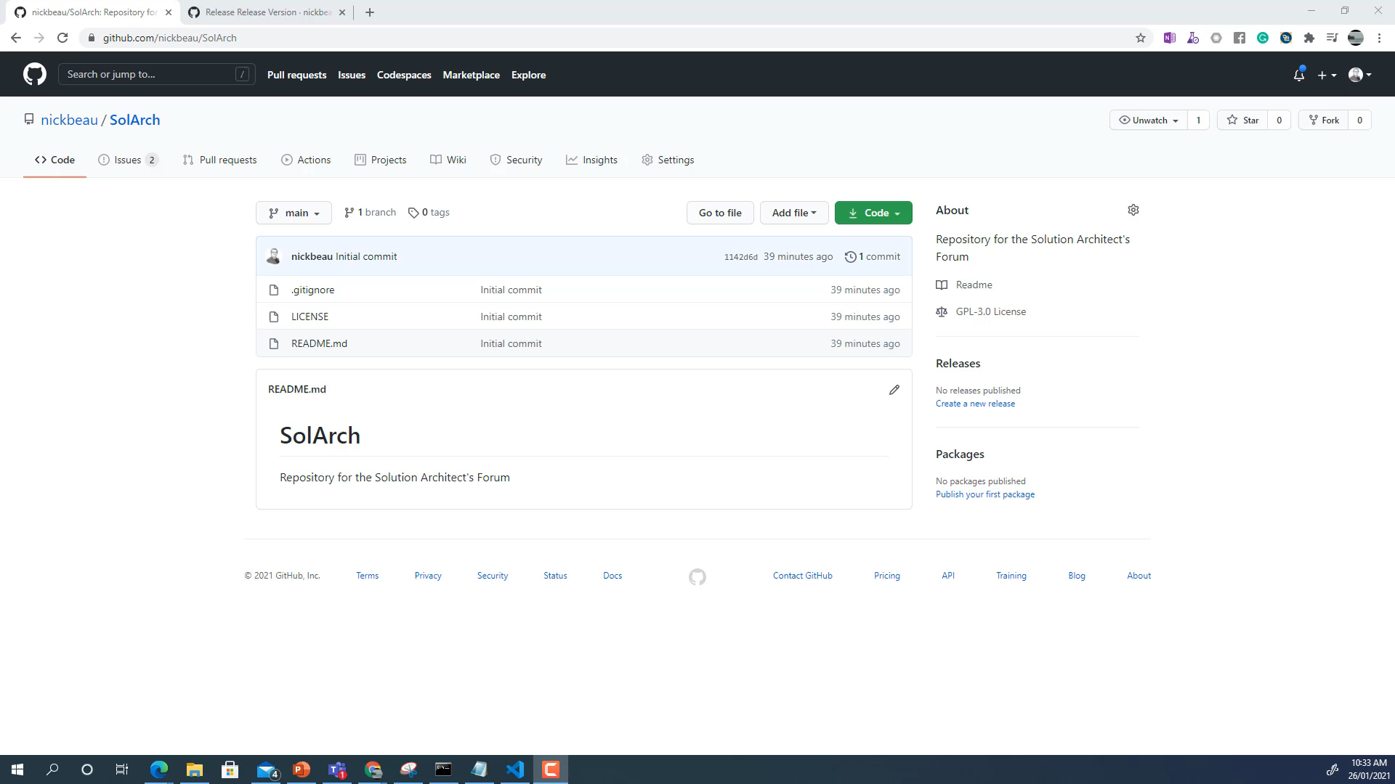

Slide 21

Demo – Producing Project Documentation

Slide 22
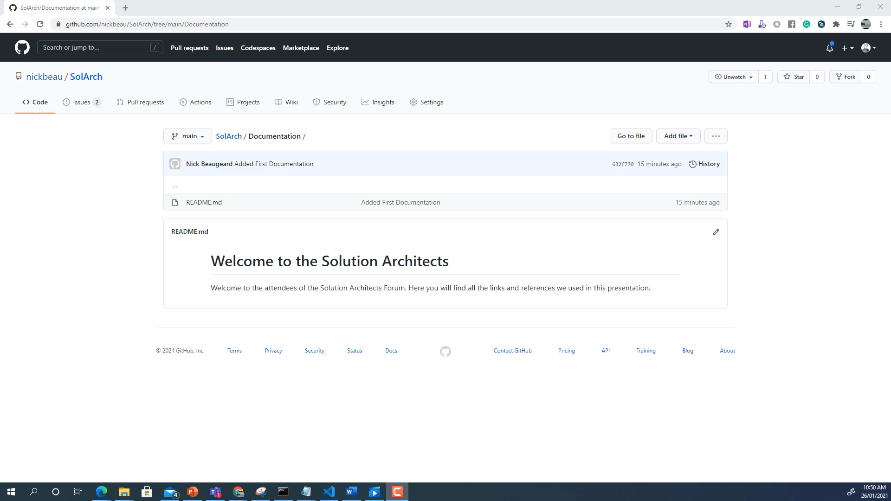

Slide 23
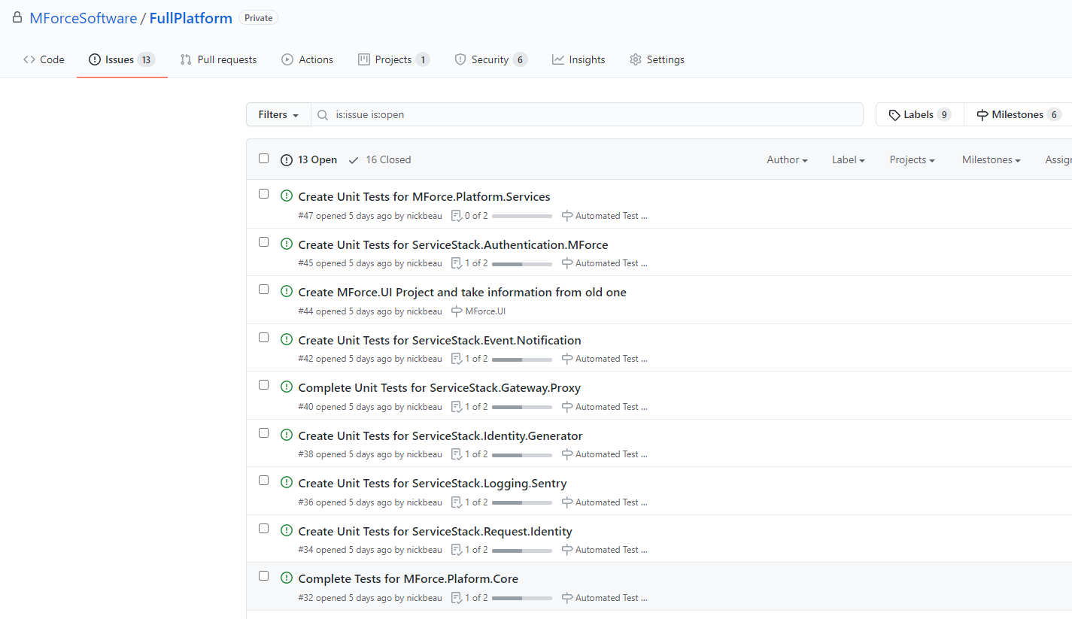
How this applies to our example
Documentation now markdown
End User Documentation published directly from GitHub
Code is being worked on through issues
Triage is regular
Quality has improved
Visibility has improved
Delivery cadence has improved

Slide 24
In Conclusion
GitHub is a superb free tool to manage projects of all types.
Used Properly it can drive any type of project, including proprietory, open source or just documentation.
All the other tools shown today are free.
Go to github.com/nickbeau/SolArch for links and more
Sign up for early access to our beta at: https://mforcesoftware.com

